Slide 1
MEDILAB Medical Diagnosis and Data Analysis
PROJECT REVIEW
Team Members: Abhishek P - 113316106001
Sri Balaji M - 113316106080
B Vamsi Krishna - 113316106015
Guided by:
Dr. B. Sridevi
Head of the Department, ECE

Slide 2
INTRODUCTION
All around the globe, there are no means to find, isolate and treat a new disease, until its too late.
People who belong in the Rural or Tribal areas are completely unreachable. They neglect medical help which makes in even more difficult.
This Proposed model would help provide medical diagnostic help in isolated/rural areas and also analyse the data from other similar devices to analyse any sudden outbursts of a particular disease.

Slide 3
MOTIVATION
206,000 cases in Bangladesh claiming 15 lives - Diarrhea
Hepatitis A Outbreak in 2017 – Colorado: 571 cases
Total Dengue cases in 2019 – Karnataka: 15232
Cholera Outbreak in Yemen: 9,94,751 cases
Death Toll of Malaria in 2007 - TamilNadu: 5449
Sources:
National Vector Borne Disease Control Programme.
Deccan Chronicle.
ContagionLive.

Slide 4
EXISTING METHOD
MANUAL OR INDIVIDUAL SERVERS:
When a particular government organization / Health Centre identifies a disease, they are updated in their individual servers which only gives an idea about their area of operation.
PERIODIC SURVEYS:
The government and NGOs get their understanding about death tolls and the total number of exposed patients only through periodic surveys, which is usually too late.
NEGLECTION:
The Uneducated population often tend to neglect their symptoms because it seems trivial. They do not go check with a doctor even if it seems to reoccur.

Slide 5
OBJECTIVE
To Construct a fully functioning Medical Diagnostic Device which can diagnose diseases and prescribe drugs even in an Isolated region.
To Constantly update the authorities if more than 10 cases (assume) for a particular disease is found in a single area.
Plot various graphical illustrations comparing various parameters.
1. Maximum number of users exposed to a disease.
2. Age group of the patients who are most affected.
3. Number of cases observed in 1, 5, 10 days… months.
4. Types of Diseases vs. Number of Patient.
4. To isolate a disease before it spreads and affects a bigger population.

Slide 6
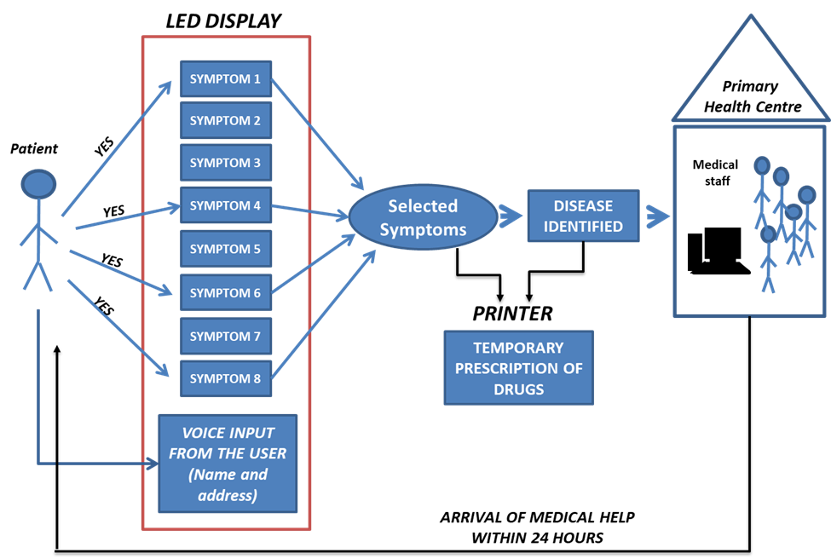
BLOCK DIAGRAM (SINGLE DEVICE)

Slide 7
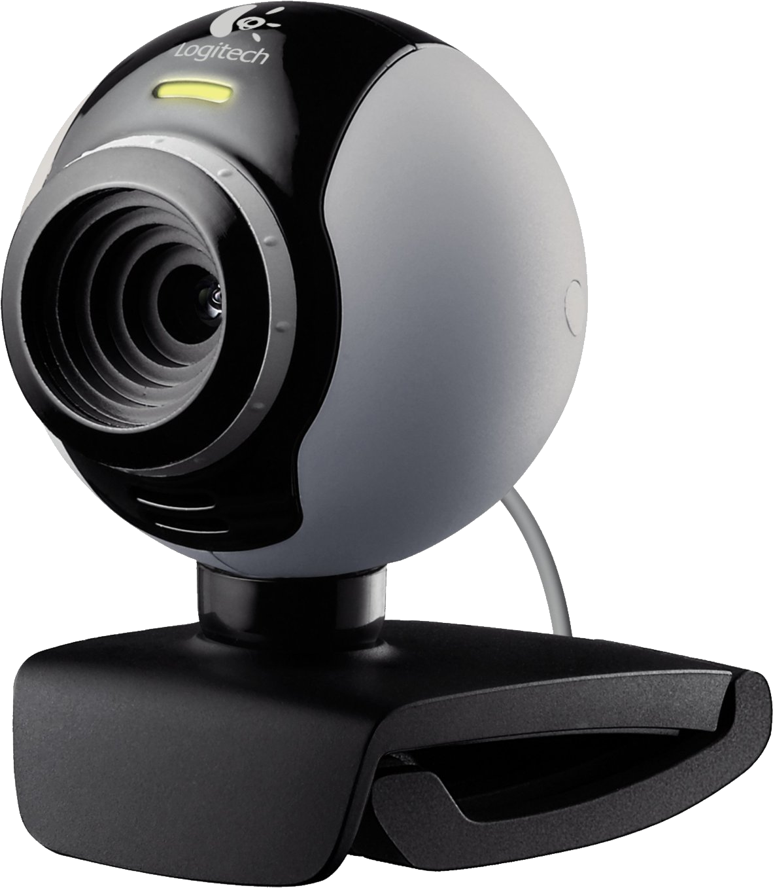
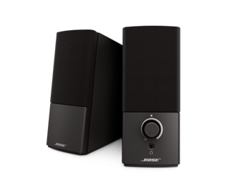
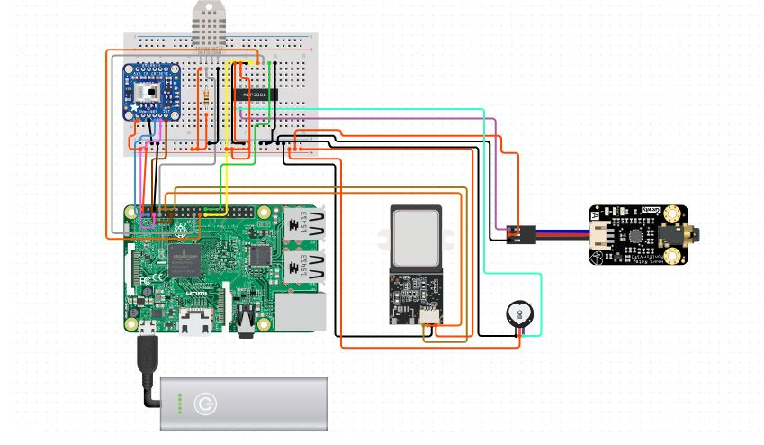
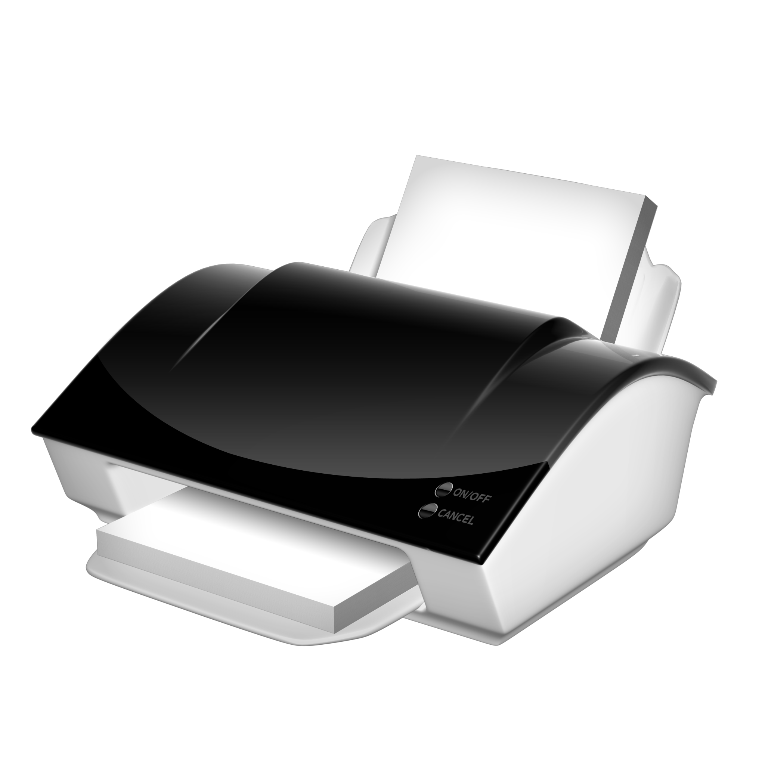
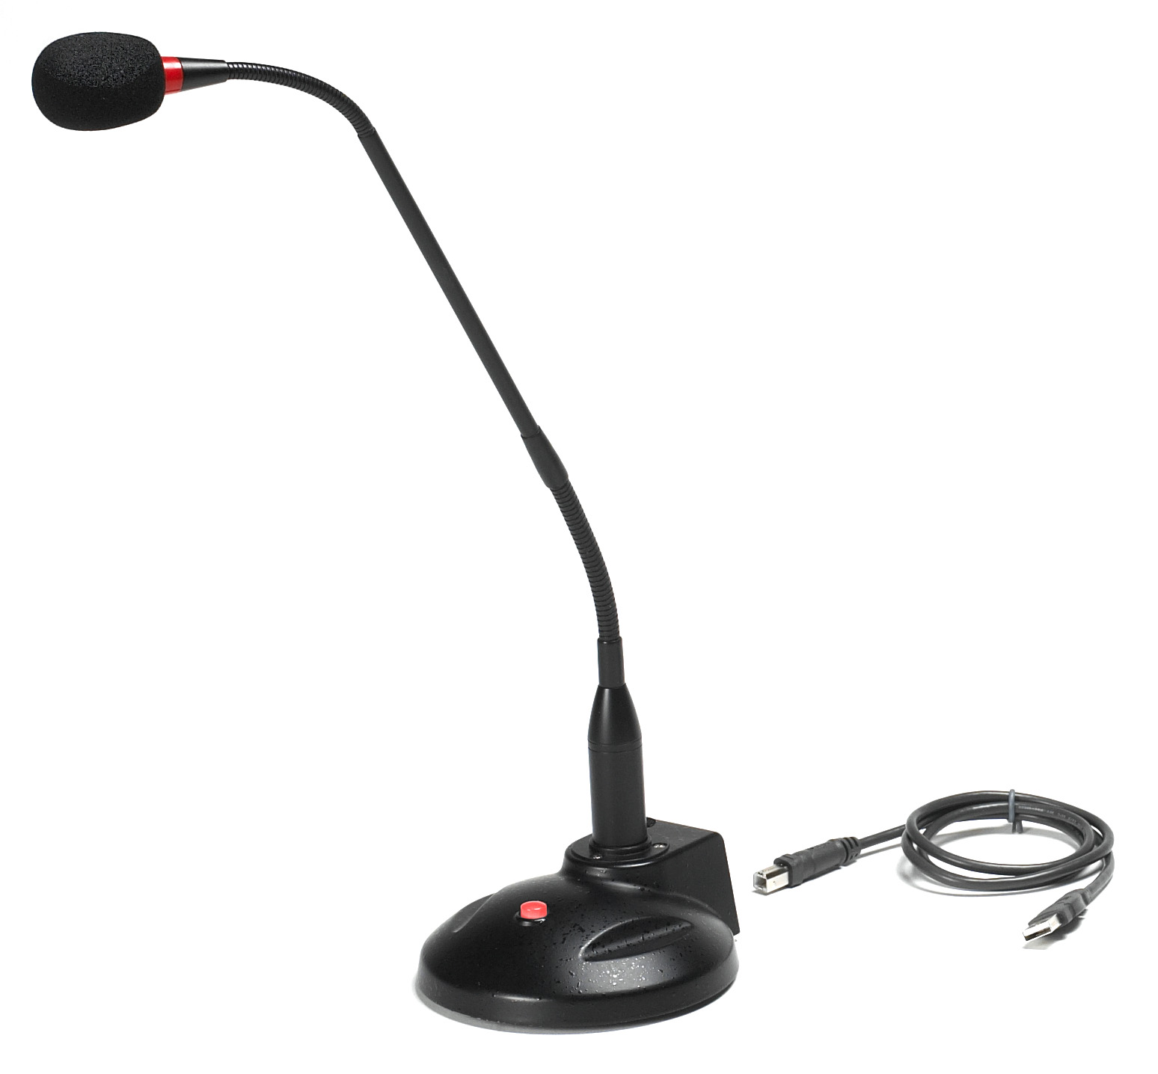
HUMIDITY SENSOR
WEBCAM
SPEAKERS
THERMAL IMAGING
SENSOR
ECG SENSOR
PRINTER
FINGER PRINT
SENSOR
HEART RATE
SENSOR
AUDIO RECORDER

Slide 8
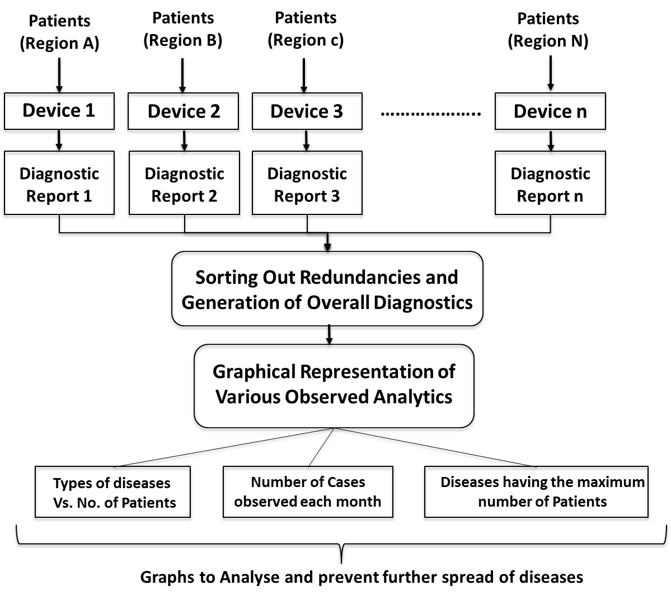
BLOCK DIAGRAM (AS A NETWORK)

Slide 9
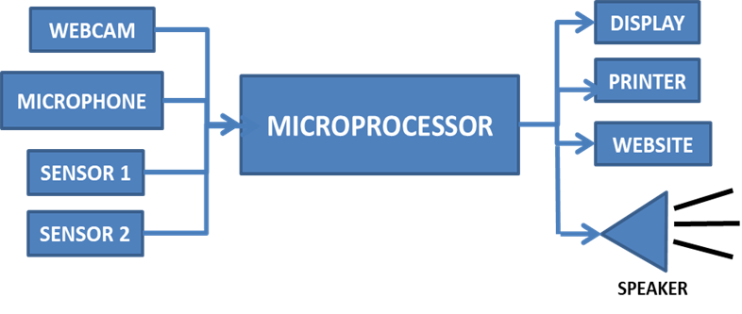
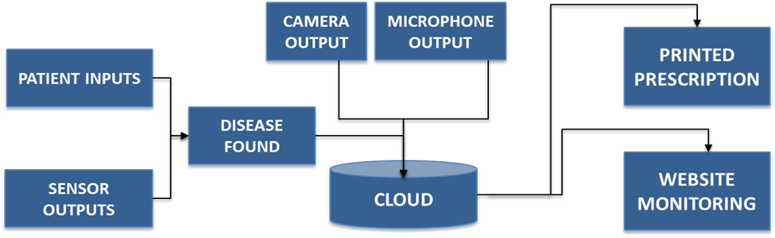
HARDWARE MODEL

Slide 10


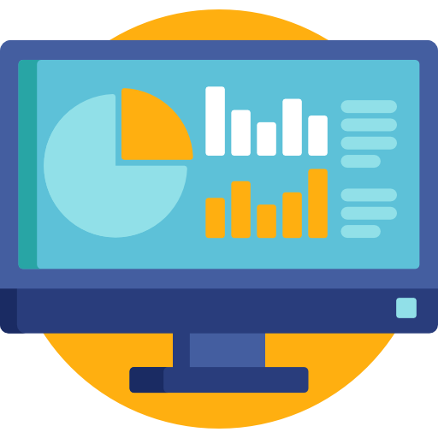
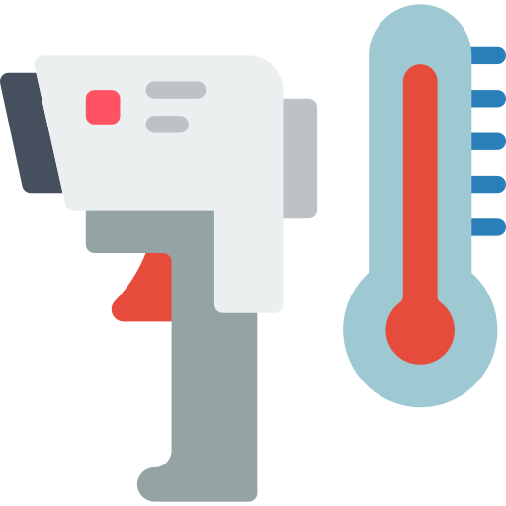
KEY ADVANTAGES
Reducing The Process / Time Taken For Diagnosis To 90 Seconds
Worked On The Database To Store & Retrieve The User Information
Started Developing A Website to know their queries and to guide them.
Integrating Bio-Sensors To Make The Process More Accurate

Slide 11
TECHNICAL STACK
HARDWARE:
Raspberry Pi
Firebase (Cloud Database)
Arduino UNO
Pulse Sensor, Temperature sensor
Microphone, Webcam, Printer
LED Display
PYTHON PACKAGES:
speech-recognition
pyrebase
cv2 (OpenCV)
matplotlib
SOFTWARE:
eSpeak (Text to Speech)
Fswebcam (To control the webcam)

Slide 12
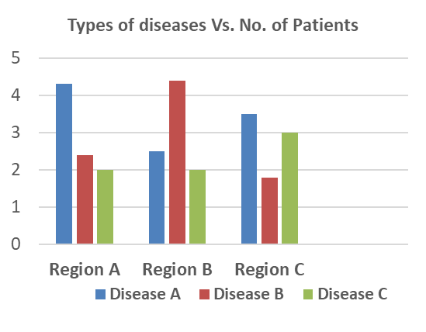
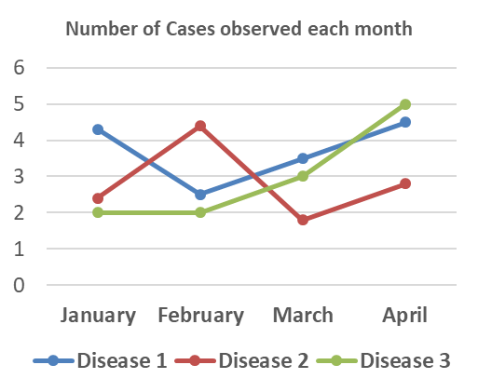
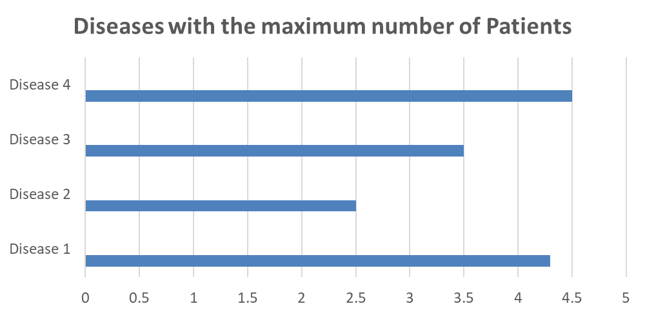
OUTPUT GRAPHS:

Slide 13
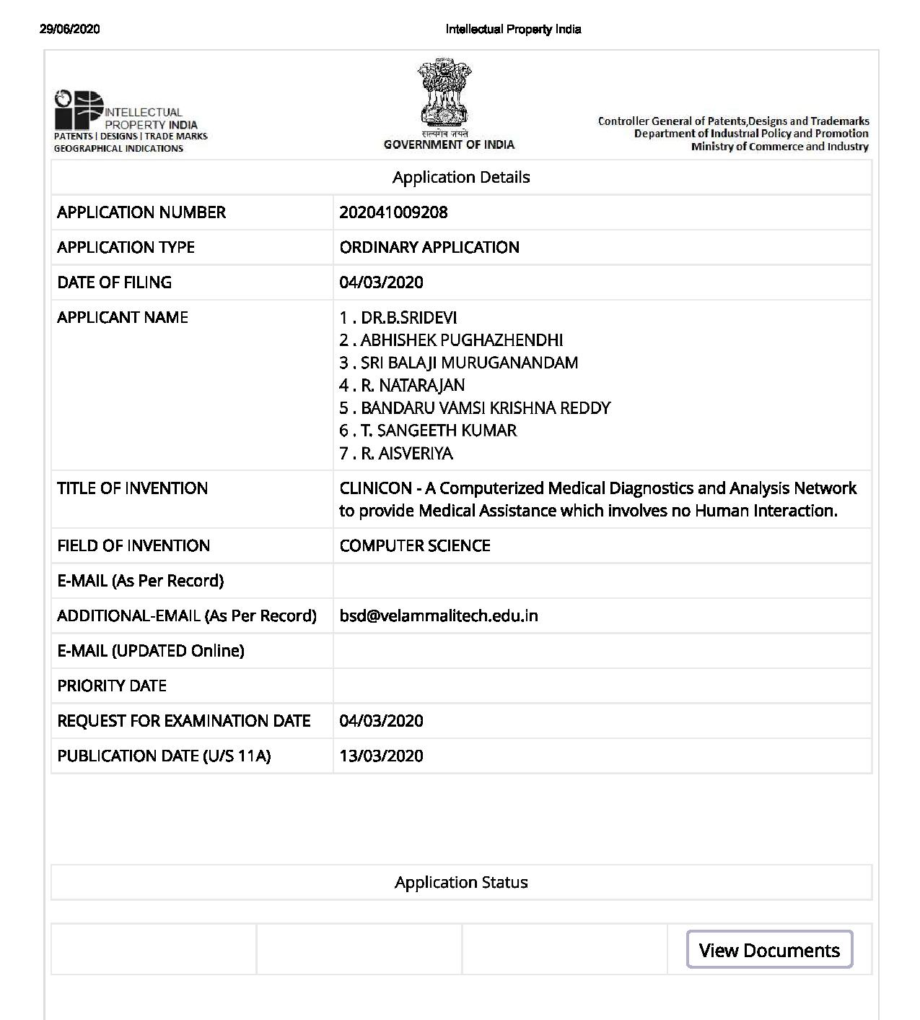
PATENTS / PUBLISHMENTS
PATENT DETAILS:
Application Number: 202041009208
Date of Filing: 04/03/2020

Slide 14
REFERENCES:
 | Journal 1 | Journal 2 | Journal 3
Advantage | Less Reaction / Processing time Improved accuracy on selected diseases | Provides meaningful insights from unprocessed data. Reduces the time taken for successive diagnosis. | An innovative approach to diagnose diseases. Impressive accuracy when used in localized areas.
Limitation | Accuracy of diagnosis is questionable Complex Programming and algorithms | Redundancy occupies much space in the system and it is hard to identify. Accuracy is questionable. | The process is extremely descriptive and Time-consuming. Might not work at every locality.
Method adopted | Including previous diagnostic results into the existing programming. | Assimilating the unorganized data into a simple interface | Approaching the patients based on the locality which they live in

Slide 15
THANK YOU
For your Time.

